Slide 1
Mid-term Project
Python and AI

Slide 2
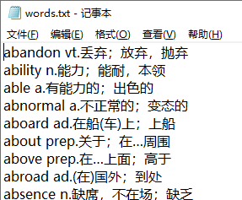
Smart English-Chinese Dictionary
Project:
Read all items from the words.txt.
Extract the English-Part and Chinese Part from each line of the words.txt.
Use Python to design a fast and smart dictionary tool for Chinese learner.
Do statistic task and draw the result.
Basic request:
Input letters and return the match words list and it’s match count.
User can select a word to show the it’s Chinese counterpart.

Slide 3
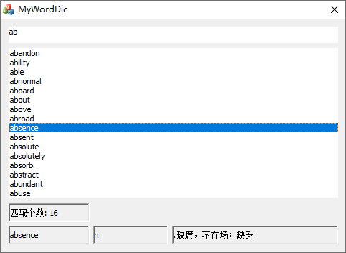
Basic Function need realize
Input letter
Return the matched list
Select one word
ab matched 16 words from the dictionary
Show all the information of item

Slide 4
Extended Function
(1) Enter Chinese word and show all possible matched English words list.
(2) Count the number of occurrences of 26 letters in the dictionary, and draw the occurrences with bar graph.
Hint
(1) You can use command mode to design the basic and extended function.（GUI is not required!）
(2) You will get bonus points if using Python OOD to design the tool.
(3) You can use any Python lib or source code to design the tool.

Slide 5
Project Report Request
Describe your software design ideas and key algorithms analysis.
Attach all your source code
Important screenshots of your designed running tool.

Slide 6
The frontpage format of you report
Mid-term Project:
Student ID:
Name:
Date

Slide 7
Warning!
Deadline
You have three weeks to design the project.
The deadline is 4-28.
Send your email to 52524599@qq.com with studentID_Name title.
Submit the printed report to me (I will tell you where to submit)
Students who submitted the same source code will be given 0 points!

Slide 8
a
b
c
z

